Slide 1
Presentation Diagram
Introduction
Preliminary material
Main contribution
Implementation
Conclusions

Slide 2
Background
Mapping and self-localization in unknown environments are fundamental capabilities in many robotic applications.
These tasks typically involve the identification of objects as unique features or landmarks, which requires the objects both to be detected and then assigned a unique identifier that can be maintained when viewed from different perspectives and in different images.
The data association and simultaneous localization and mapping (SLAM) problems are, individually, well-studied in the literature.
But these two problems are inherently tightly coupled, and that has not been well-addressed.
Without accurate SLAM, possible data associations are combinatorial and become intractable easily. Without accurate data association, the error of SLAM algorithms diverge easily.

Slide 3
SLAM with Objects using a Nonparametric Pose Graph
Nonparametric pose graph that models data association and SLAM in a single framework. An algorithm is further introduced to al ernate between inferring data association and performing SLAM. Experimental results show that our approach has the new capability of associating object detections and localizing objects at the same time, leading to significantly better performance on both the data association and SLAM problems than achieved by considering only one and ignoring imperfections in the other.

Slide 4
How the Paper relate to the Course

Slide 5
Presentation Diagram
Introduction
Preliminary material
Main contribution
Implementation
Conclusions

Slide 6
Front-end Data Association

Slide 7
Back-end Robust SLAM

Slide 8
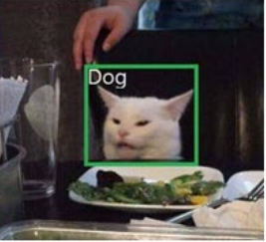
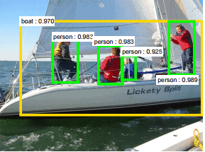
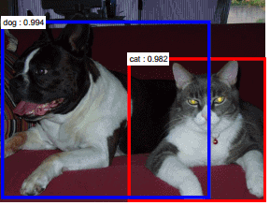
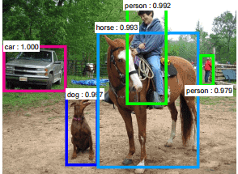
Object detection using deep learning
Some recent work on Region-based Convolutional Neural Networks [12, 13] gained significant success on training deep learning models to detect multiple objects instances within a single image. However, object detections only suggest the existence of objects of certain predefined object classes in an image, but provide no data association between images.

Slide 9
Presentation Diagram
Introduction
Preliminary material
Main contribution
Implementation
Conclusions

Slide 10
OBJECT MEASUREMENTS VIA DEEP LEARNING
Object SLAM with deep learning object detection has two major challenges:
Multiple instances of the same object class.
High false positive rates.
Standard posegraph SLAM algorithms can only optimize poses with exact data association, such as g2o, isam, gtsm.

Slide 11
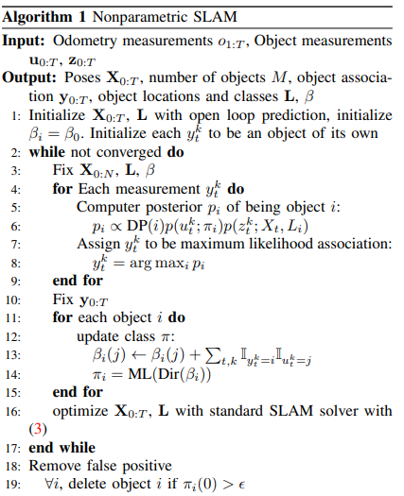
Algorithm

Slide 12
EXPERIMENT

Slide 13
CONCLUSION

Slide 14
Presentation Diagram
Introduction
Preliminary material
Main contribution
Implementation
Conclusions

Slide 15
3D Simulation

Slide 16
Presentation Diagram
Introduction
Preliminary material
Main contribution
Implementation
Conclusions

Slide 17
Whey to improve

Slide 18
Our Conclusions

